Slide 1
The Physical Layer
Chapter 2

Slide 2
The Theoretical Basis for Data Communication
Fourier Analysis
Bandwidth-Limited Signals
Maximum Data Rate of a Channel

Slide 3
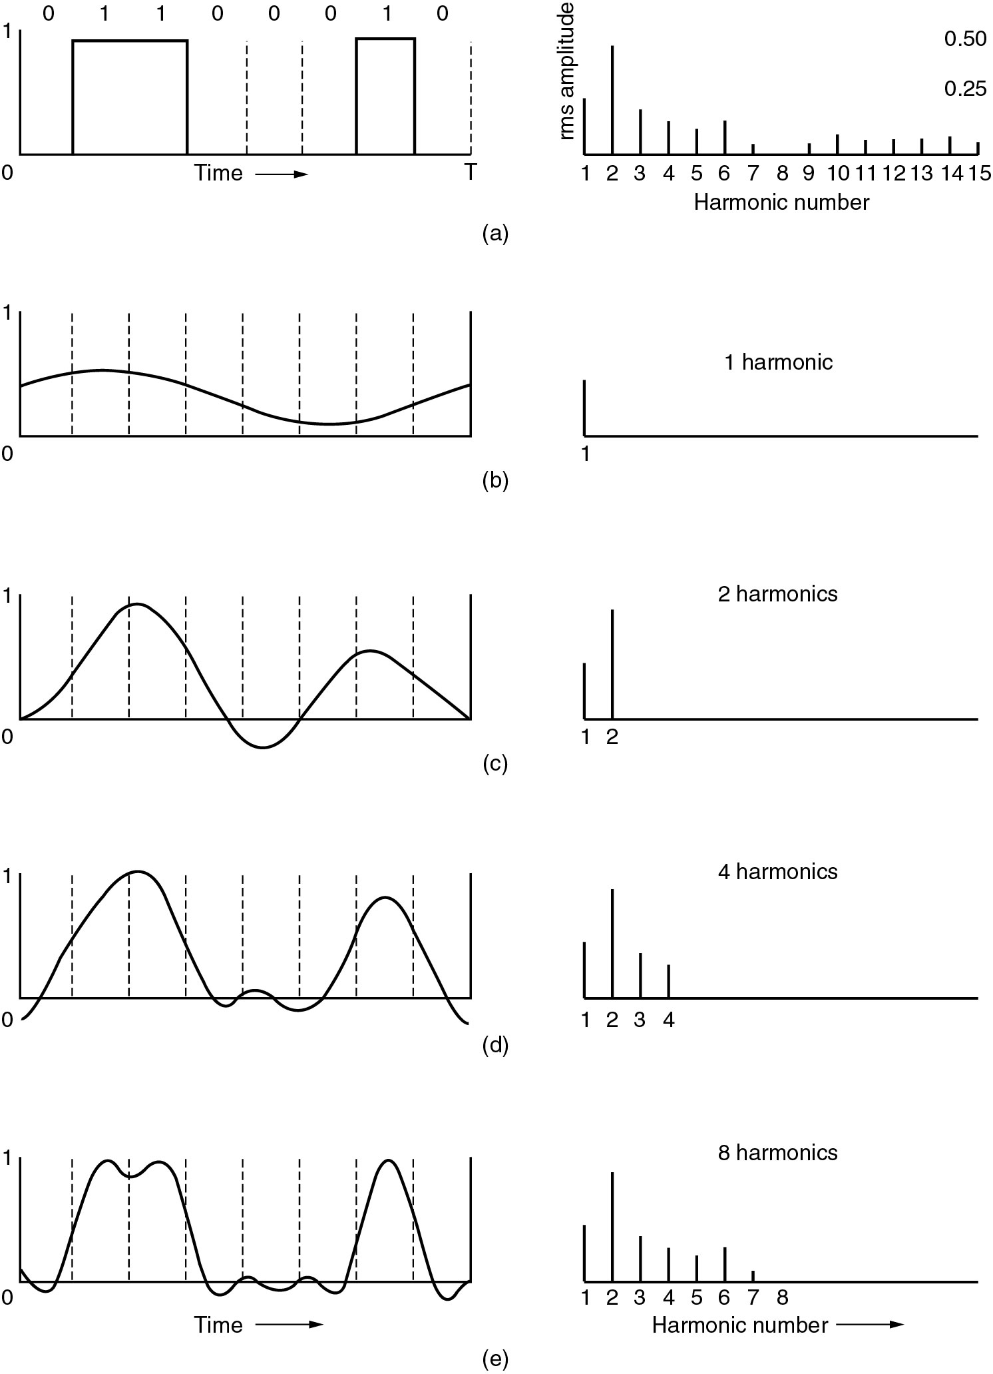
Bandwidth-Limited Signals
A binary signal and its root-mean-square Fourier amplitudes.
(b) – (c) Successive approximations to the original signal.

Slide 4
Bandwidth-Limited Signals (2)
(d) – (e) Successive approximations to the original signal.

Slide 5
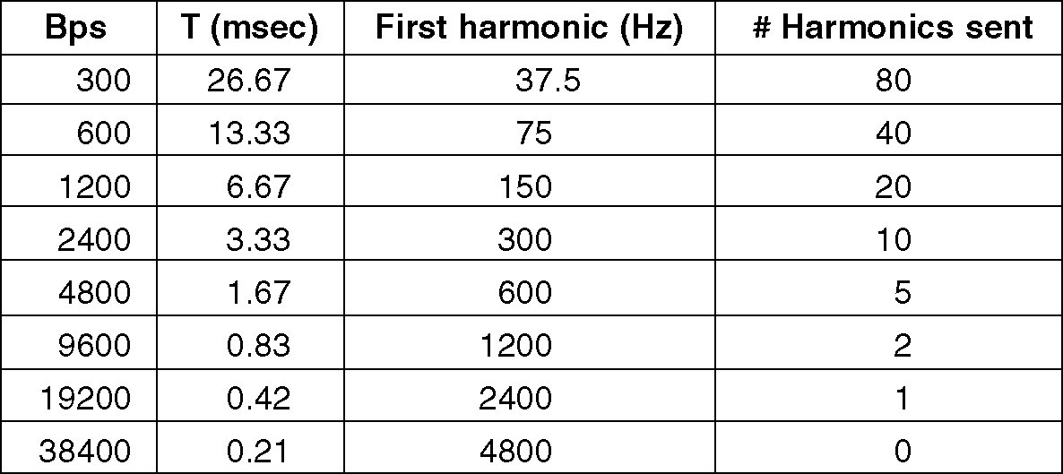
Bandwidth-Limited Signals (3)
Relation between data rate and harmonics.

Slide 6
Guided Transmission Data
Magnetic Media
Twisted Pair
Coaxial Cable
Fiber Optics

Slide 7
Twisted Pair
(a) Category 3 UTP.
(b) Category 5 UTP.
Twisting done to stop cross-talk

Slide 8
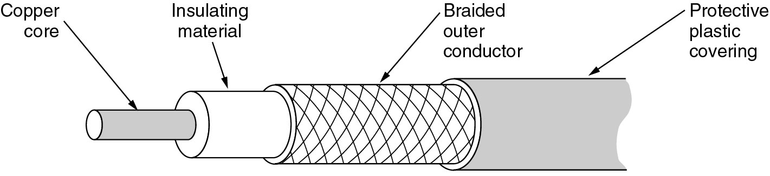
Coaxial Cable
A coaxial cable.

Slide 9
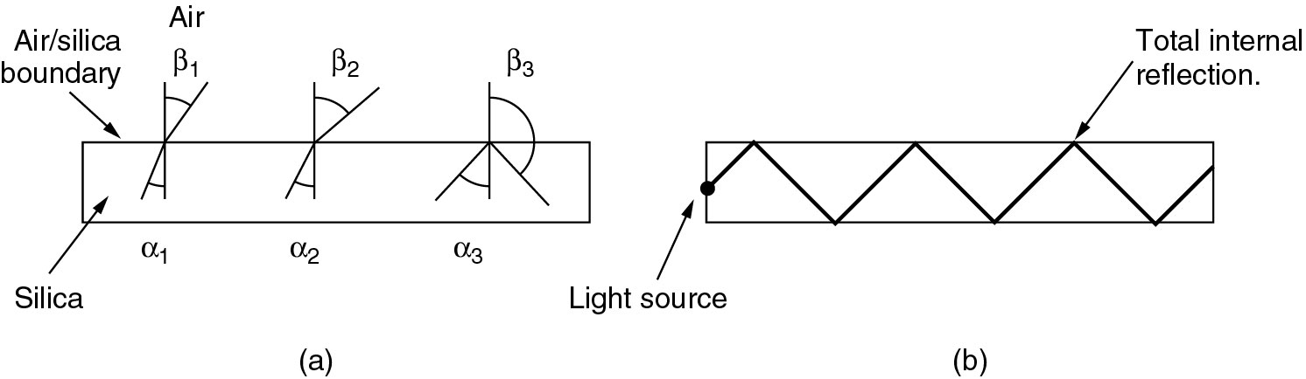
Fiber Optics
(a) Three examples of a light ray from inside a silica fiber impinging on the air/silica boundary at different angles.
(b) Light trapped by total internal reflection.

Slide 10
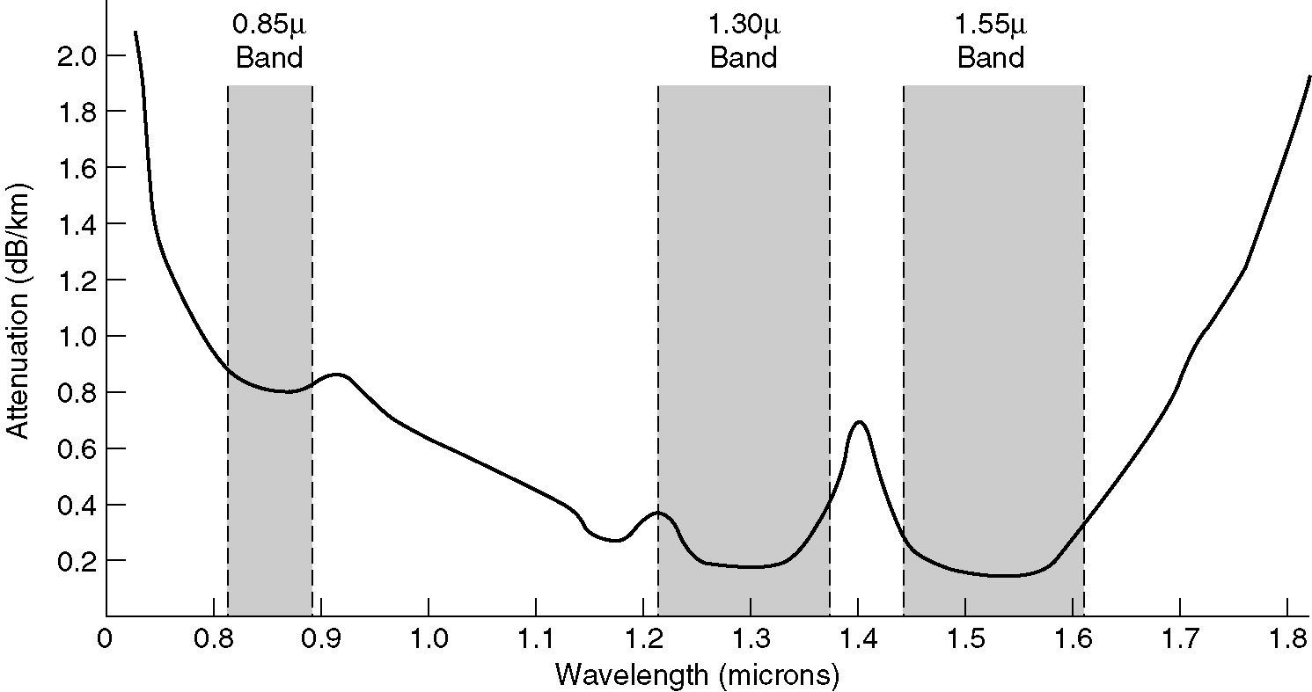
Transmission of Light through Fiber
Attenuation of light through fiber in the infrared region.
Attenuation in decidels = 10 log_10 (transmitted power/received power)

Slide 11
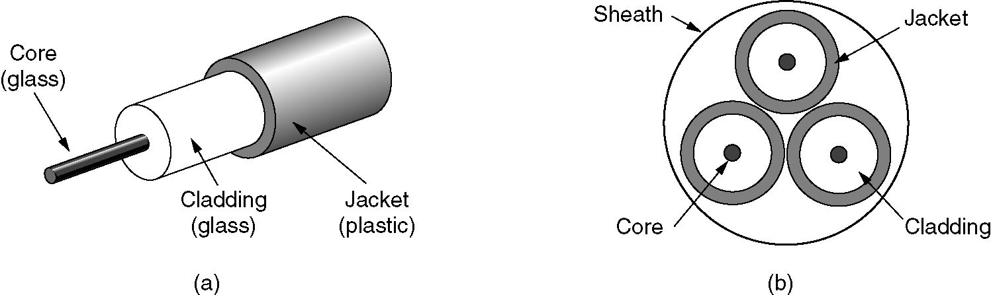
Fiber Cables
(a) Side view of a single fiber.
(b) End view of a sheath with three fibers.
Terminate in connector 15-20% LOSS
Spliced mechanically 10% loss
3. Fused to form solid connection

Slide 12
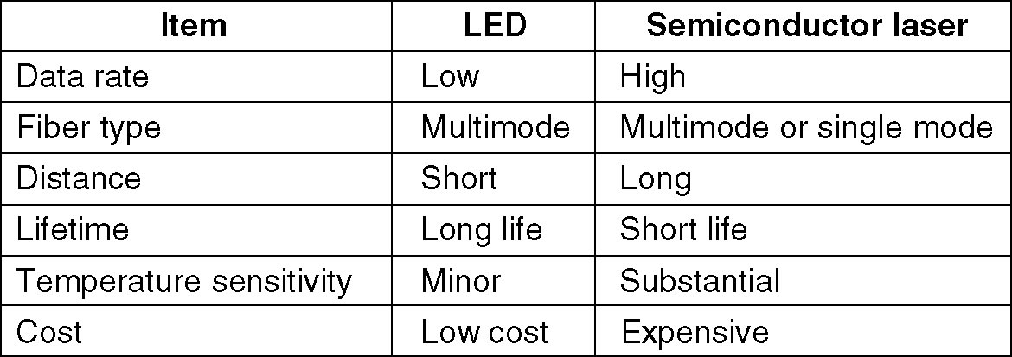
Fiber Cables (2)
A comparison of semiconductor diodes and LEDs as light sources.

Slide 13
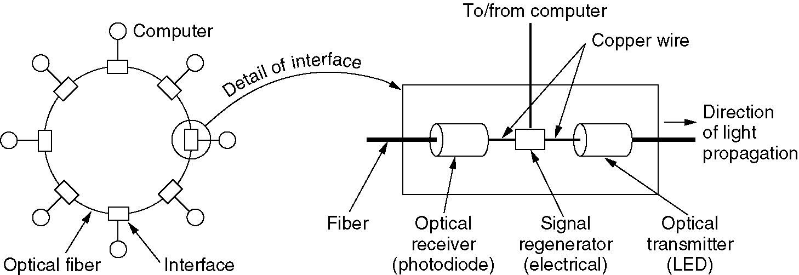
Fiber Optic Networks
A fiber optic ring with active repeaters.

Slide 14
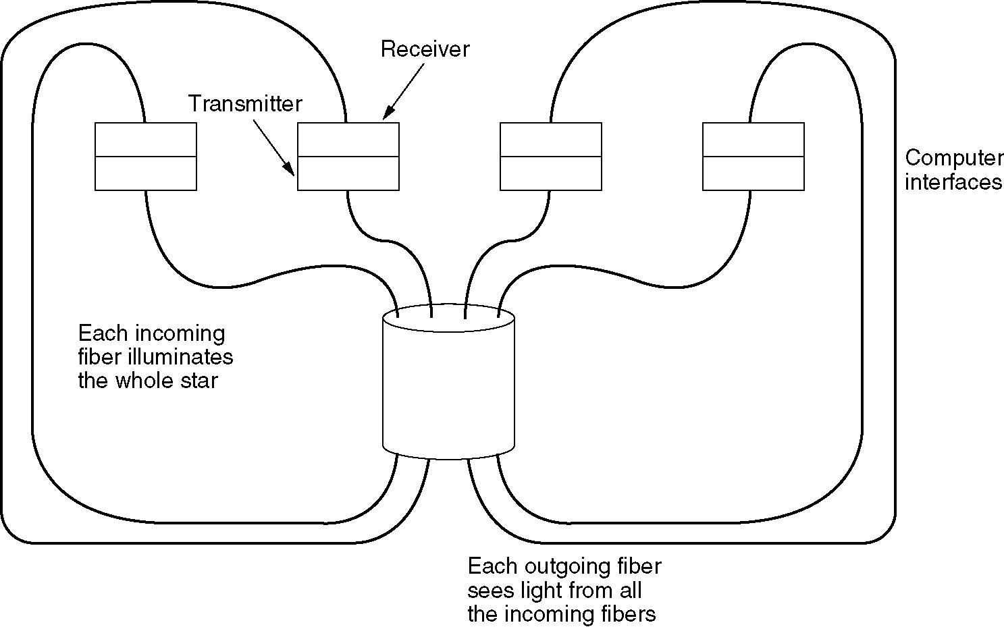
Fiber Optic Networks (2)
A passive star connection in a fiber optics network.

Slide 15
Advantages
Low attenuation, long lines – 50 km
Power surges, electromagnetic interference, power failure
Lightweight
Do not leak light, quite difficult to tap
Less familiar technology

Slide 16
Class till here

